Slide 1

ECE2050 Digital Logic and Systems Tutorial 2
Huaiyu Li
223010059@link.cuhk.edu.cn
2025.02

Slide 2

Decimal to Binary Conversion
Two methods:
Method 1: Find the largest power of 2 that fits, subtract and repeat
Method 2: Repeatedly divide by 2, remainder goes in next most significant bit

Slide 3
Decimal to Binary Conversion
Q1:
Convert 53₁₀ to binary.
Method 1: Find the largest power of 2 that fits, subtract and repeat
Method 2: Repeatedly divide by 2, remainder goes in next most significant bit

Slide 4
Decimal to Binary Conversion
A1:
Method 1: Find the largest power of 2 that fits, subtract and repeat
53₁₀
53-32 = 21
21-16 = 5
5-4 = 1
32×1
16×1
4×1
1×1
= 110101₂

Slide 5
Decimal to Binary Conversion
A1:
Method 2: Repeatedly divide by 2, remainder goes in next most significant bit
53₁₀ =
53/2 = 26 R1
26/2 = 13 R0
13/2 = 6 R1
6/2 = 3 R0
3/2 = 1 R1
1/2 = 0 R1
= 110101₂

Slide 6
Two’s Complement Numbers
Q2:
Reverse the sign of 6₁₀ = 0110_{2,} Represent the result in two's complement form.

Slide 7
Two’s Complement Numbers
A2:
Reverse the sign of 6 = 0110, Represent the result in two's complement form.
1. 1001
2. + 1
1010₂ = -6₁₀

Slide 8
Two’s Complement Examples
Q3:
What is the decimal value of the two’s complement number
1001₂?

Slide 9
Two’s Complement Examples
A3:
What is the decimal value of the two’s complement number 1001₂?
1. 0110
2. + 1
0111₂ = 7₁₀, so 1001₂ = -7₁₀

Slide 10
Subtraction with Signed Numbers
Q4:
3 – 5 =

Slide 11
Subtraction with Signed Numbers
A4:
1. 3 – 5 = 3 + (-5)
2. 0011 | 3
+ 1011 | -5
1110 | -2

Slide 12
Binary Coded Decimal (BCD)
Q5:
In a binary coded decimal (BCD) system, 4 bits are used to represent
a decimal digit from 0 to 9. For example, 37 is written as 00110111BCD.
Write 371 in BCD.
Convert 000110000111BCD to decimal.
Convert 10010101BCD to binary.

Slide 13
Binary Coded Decimal (BCD)
A5:
Write 371 in BCD.
0011 0111 0001
Convert 000110000111BCD to decimal.
187
Convert 10010101BCD to binary.
95 = 1011111

Slide 14
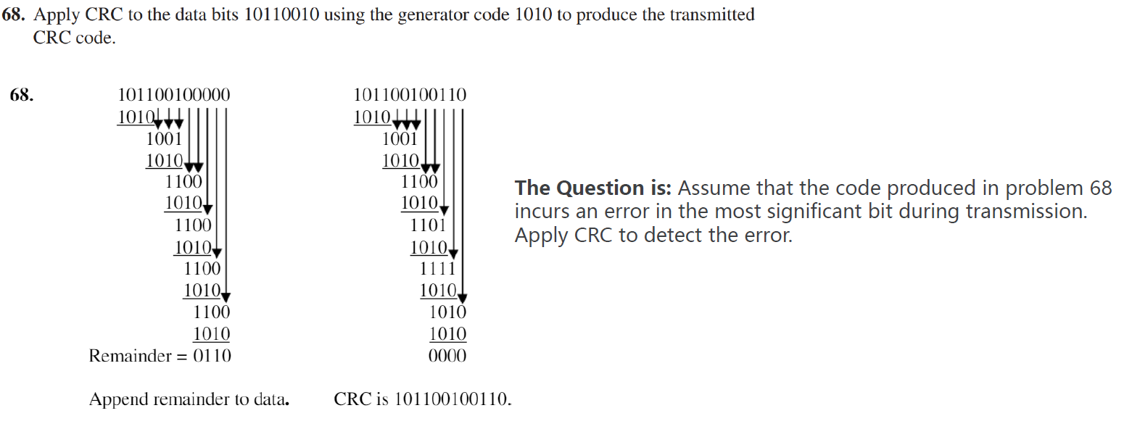
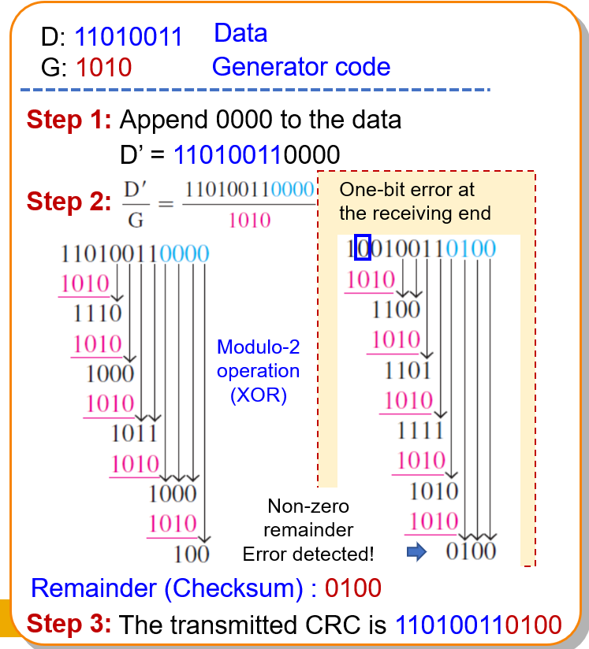
Error Codes: Cyclic Redundancy Check
Q6

Slide 15
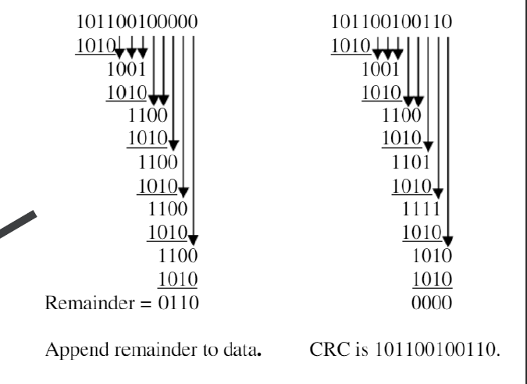
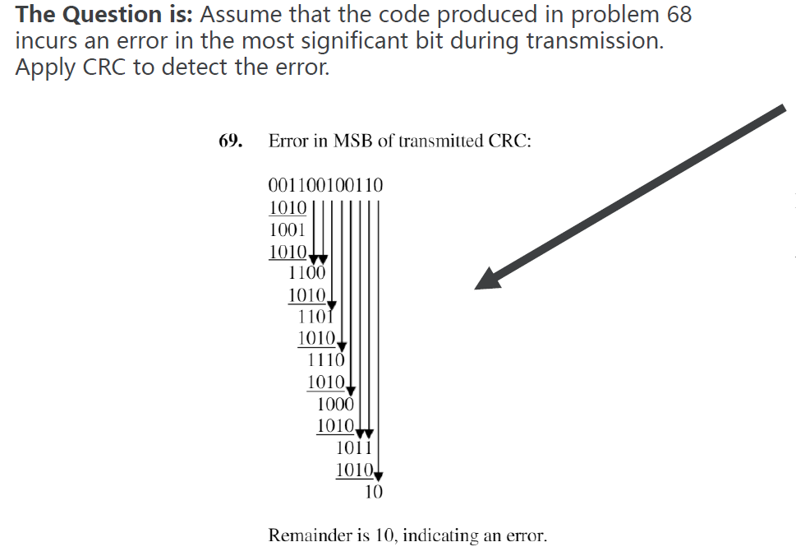
Error Codes: Cyclic Redundancy Check
A6

Slide 16
Q&A

Slide 17
Thank You!

